Slide 1
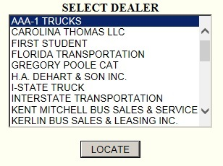
TUTORIAL
In order to experience the full benefits of your Warranty, it is imperative that your RAC system(s) be registered completely and accurately. Failure to properly register the system, will adversely affect the availability of Warranty Coverage. A properly registered system will enable RAC Warranty Department to respond in a speedy manner, in the likely event of a Warrantable failure.
To register online and/or check your Warranty status, please click on Dealer Login. If you are in need of your Dealer Login/Password please contact the RAC Warranty Department
For the purpose of this tutorial an example Dealer has been created AAA-1 TRUCKS

Slide 2
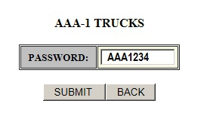
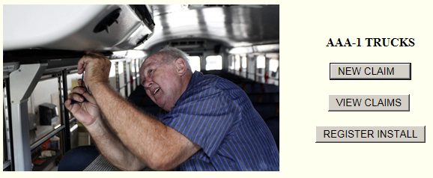
All dealers must enter an authorized password to enter.
Authorized Entry
Before a NEW CLAIM may be entered, the installation must be registered.

Slide 3
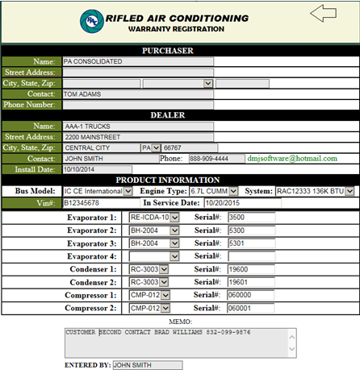
REGISTER INSTALL
REGISTER INSTALLATION
Warranty registration must be completely filled out and submitted.

Slide 4
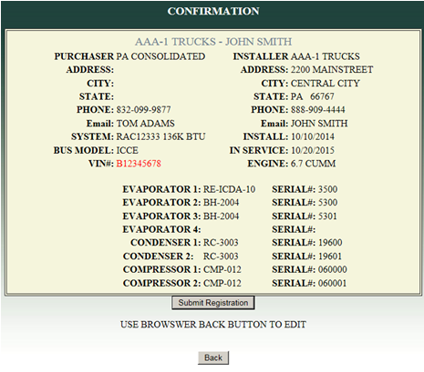
INSTALLATION CONFIRMATION
Once submitted a confirmation form will appear allowing the user to submit or edit by going back.

Slide 5
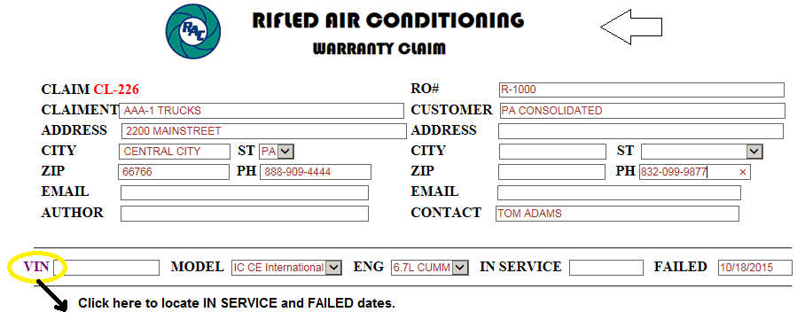
NEW WARRANTY CLAIM
We will use the new registration for this claim.
Enter Vin# (if known) or Enter Customer Name.

Slide 6
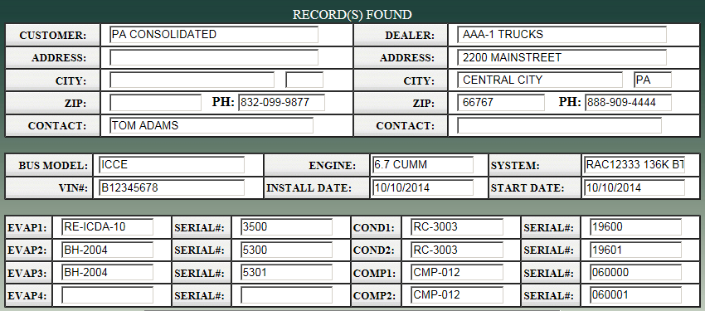
REGISTRATION QUERY
CUSTOMER - Enter Customer Name (partial name allowed).
Query result lists all records containing PA C
Successful SEARCH locates all registration data.

Slide 7
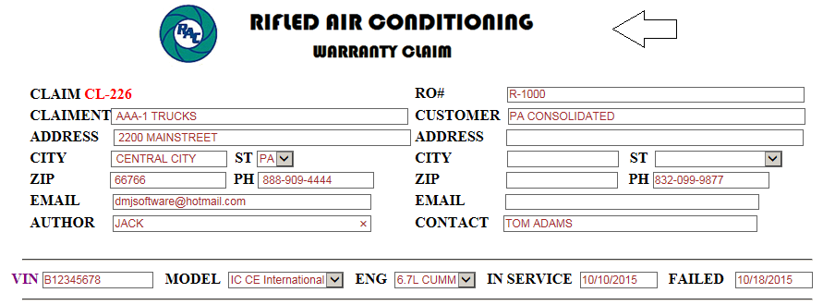
Copy and Paste Data into the Claim
There are 10 entries for Parts. The NET column will be automatically tabulated upon submission.

Slide 8
LABOR
Labor Descriptions are selected by clicking on the appropriate list box. For a description not listed enter MISC and enter description in the MEMO box.
Labor Allowances are automatically generated and need not be selected. If special circumstances require additional time allowances can be overwritten and may be considered – note in memo box. Registered warranty flat rate times can be viewed- http://rifledair.com/warranty-labor-rate.
Labor Rate $ 85.00 is the fixed allowable rate honored by RAC. Although the rate can be overwritten, it is subject to be rejected by RAC.

Slide 9
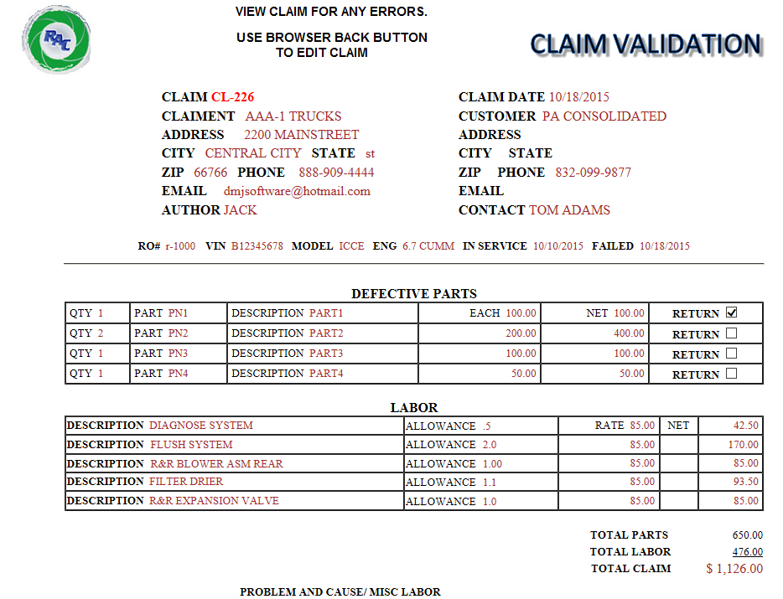
FINAL CLAIM VALIDATION BEFORE SUBMITTING TO RAC

Slide 10
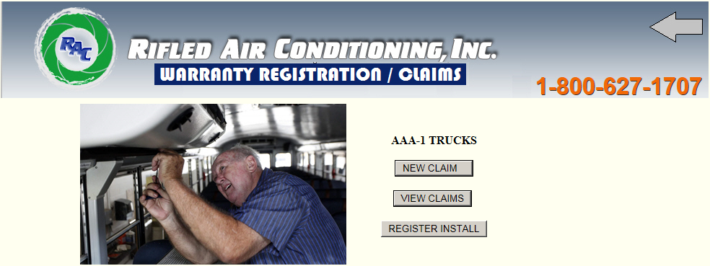
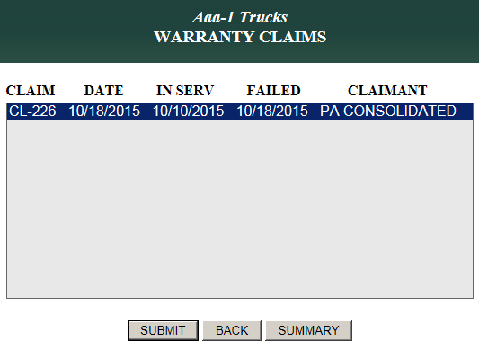
AFTER SUBMISSION YOU WILL BE RETURNED TO YOUR ACCOUNT
NOW BY CLICKING VIEW CLAIMS A LISTING WILL APPEAR.

Slide 11
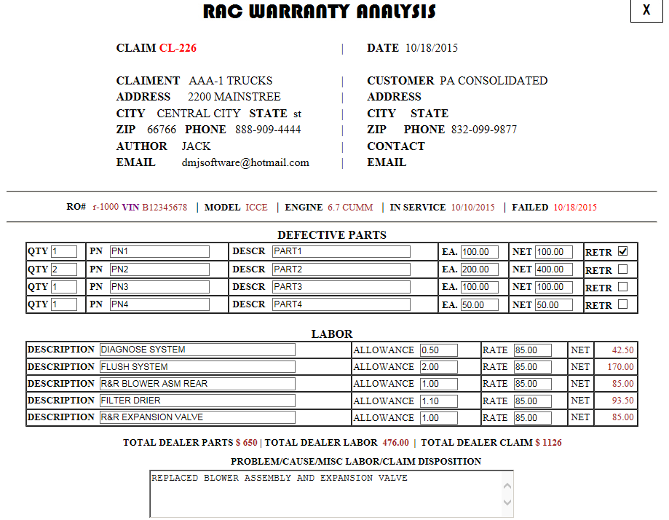
Claims can be viewed by clicking on the list box. An email is generated to RAC notifying them of the new CLAIM

Slide 12
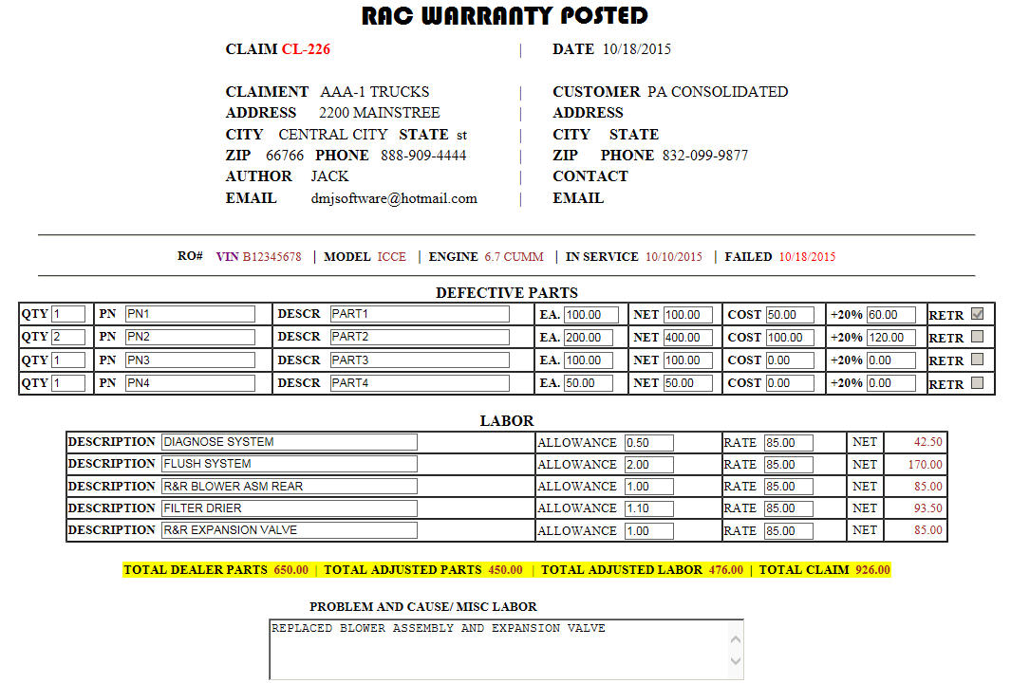
Once RAC processes your claim it will show up as POSTED
Note two part prices were adjusted on this claim. RAC allows a maximum of 20% above their parts costs. New Claim approval $926.00

Slide 13
We hope this tutorial has been beneficial for your understanding of how our warranty claims are processed. Our online warranty program is established to better serve our dealers, to provide a timelier service and warranty repairs with less downtime and hassle.
If you have any questions or are in need of your dealer/login/Password please contact me.
Tara Pfaff, Warranty Administrator
tpfaff@rifledair.com
336-434-1000 ext. 104

